Slide 1
University of Georgia
School of Science and Technologies
MENVIPRO - 2022
GIS technology for environmental monitoring
Prof. Sergo Tsiramua
George Tsiramua
Tbilisi - 2022

Slide 2
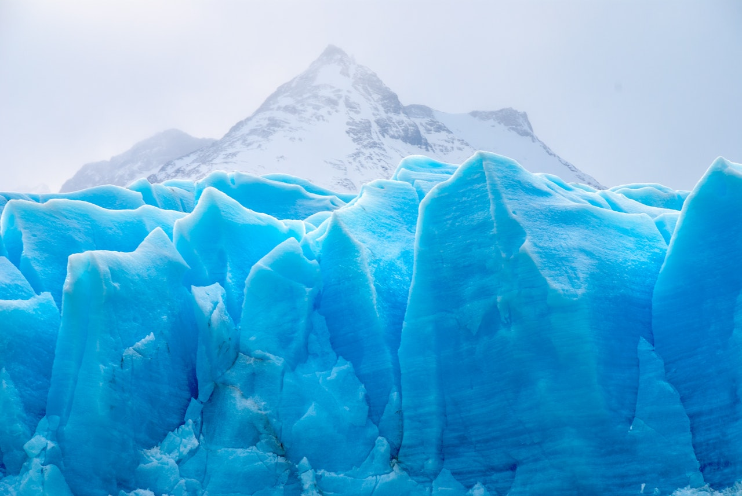
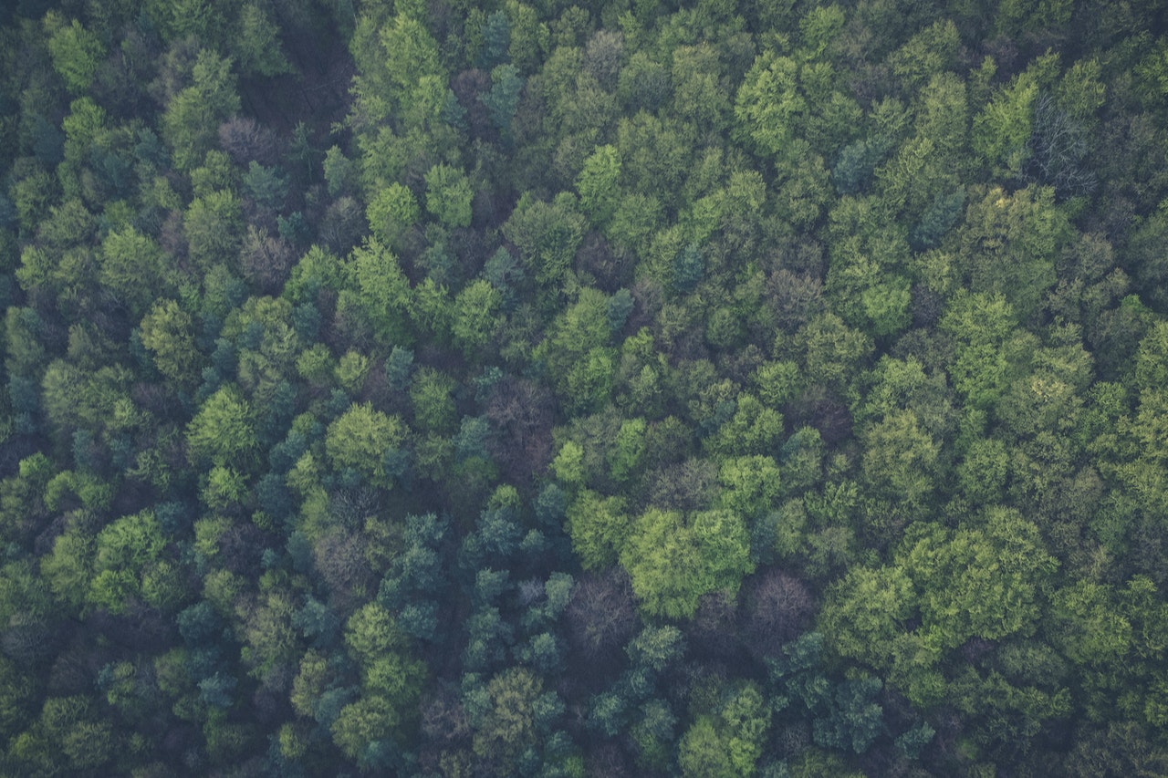
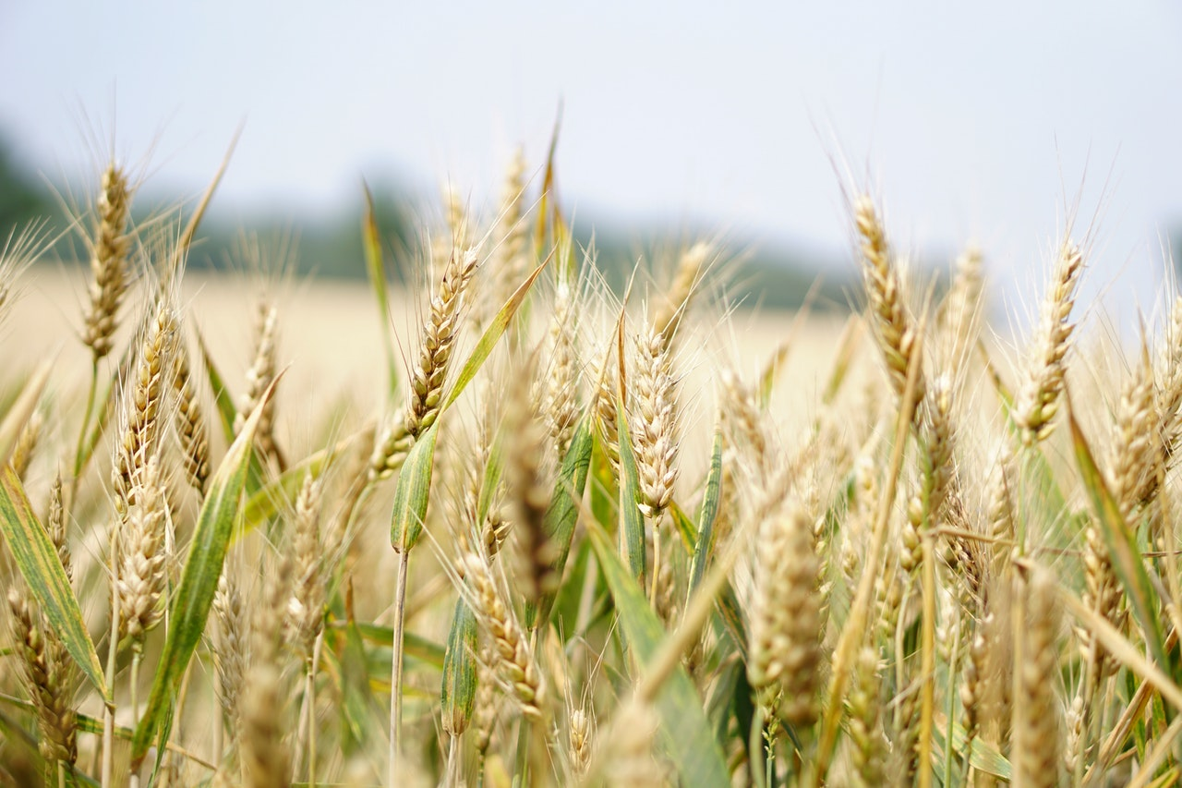
Notes:
Perhaps the most important concern for all of us today is protecting the environment we live and breathe in. Climate change issues are creating havoc with erratic weather patterns affecting everything from crop production to untimely melting of ice glaciers. There is a lot to worry about and immediate action is definitely required. It’s not that the world has not geared up to take corrective actions, but we need to do more, and GIS can help us achieve that. GIS is a powerful tool. It is enabling every sector to perform better and the environment is no exception.

Slide 3
GIS can help
Monitoring environmental changes
Air quality monitoring
Glacier area
Forest degradation
Environmental data analysis and planning
Disaster management and prevention
Forest fire management
Landslides prediction and management
Managing natural resources
Managing eco and sustainable tourism

Slide 4
Outline
What is GIS
GIS projects in Georgia
GIS in The University of Georgia
GIS Bachelors and Masters thesis
GIS in Sustainable tourism development
Our experience in GIS technologies

Slide 5
Few words about authors
Sergo Tsiramua
Head of GIS team in Word Bank Project – land registration GIS system (1998-2004)
Head of GIS team in Italian Government Project SETA – seismic monitoring stations in Tbilisi. Live data is transferred to information center of Institute of Geophysics (2005-2006)
Founder of Tourism Geoinformation Center (2011 - …)
George Tsiramua
Head of GIS team in Silkent – GIS systems of communication infrastructure (2010-2012)
Founder of Biliki App (2019 - …)

Slide 6
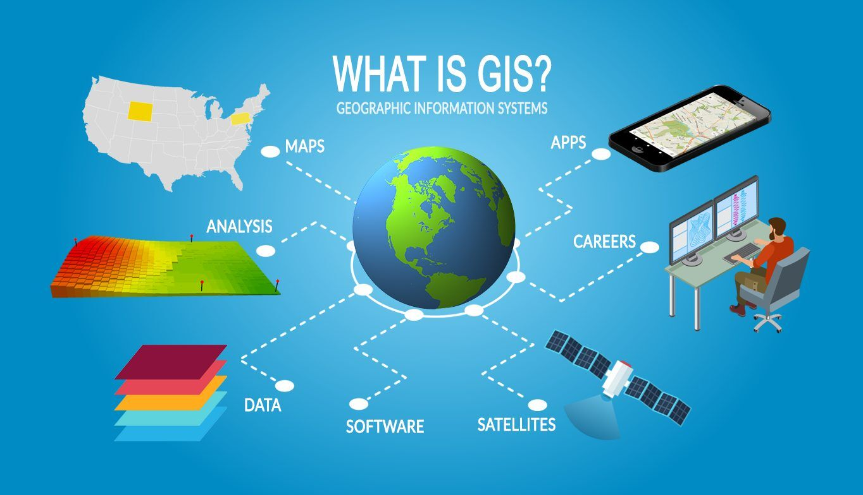
What is GIS
Geoinformation Systems
Store, analyze, and visualize data
Used for:
Monitoring
Evaluating
Predicting
Modeling
Spatial Analysis
…

Slide 7
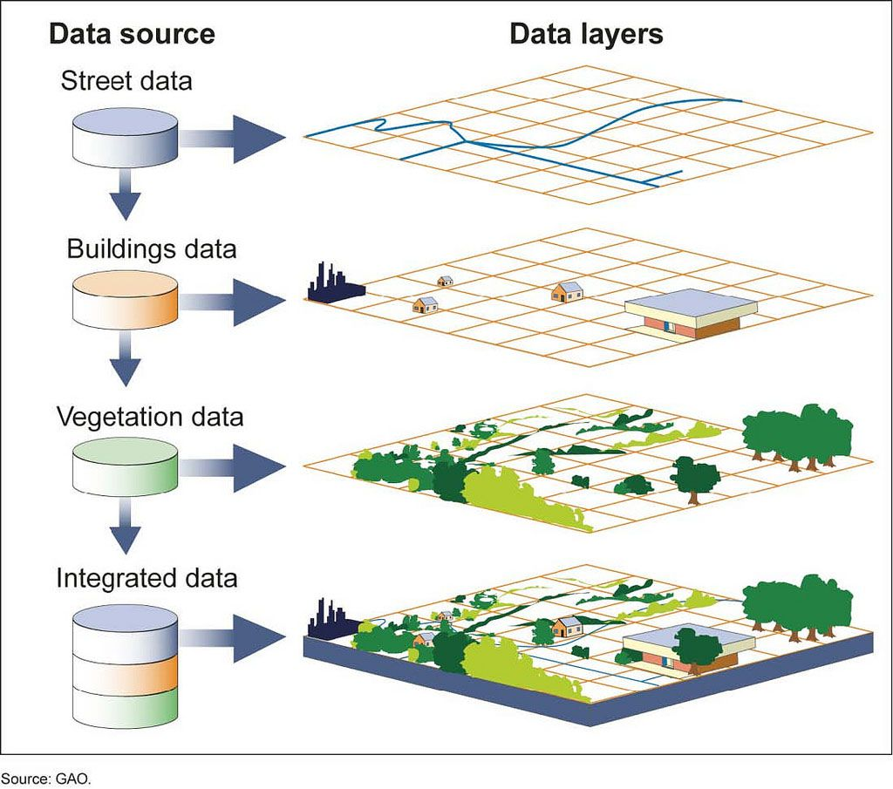
GIS includes
A set of spatial objects and data
Raster or vector digital maps of different themes and scales in real geographic coordinates
A tool for creating interactive digital maps of various purposes with relevant databases
A tool for quickly finding, selecting, sorting, filtering objects on a digital interactive map
…

Slide 8
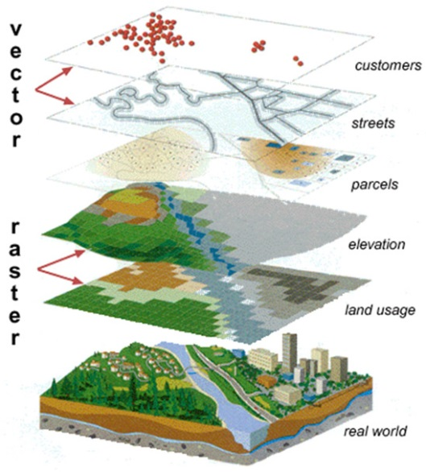
Layers in GIS
Special Data is represented in Layers
Layer can be raster or vector
Raster layer – satellite image
Vector layer – point, line, areas
Monitoring systems
Trees
Houses
Streets
Rivers
Forests
…

Slide 9
GIS can answer questions
What objects are located on the given location or area?
Where is specific object located?
What do we know about given object?
Where can we locate new object?
What and how will situation or area change in specific conditions?
What will be the affects of these changes?
….

Slide 10
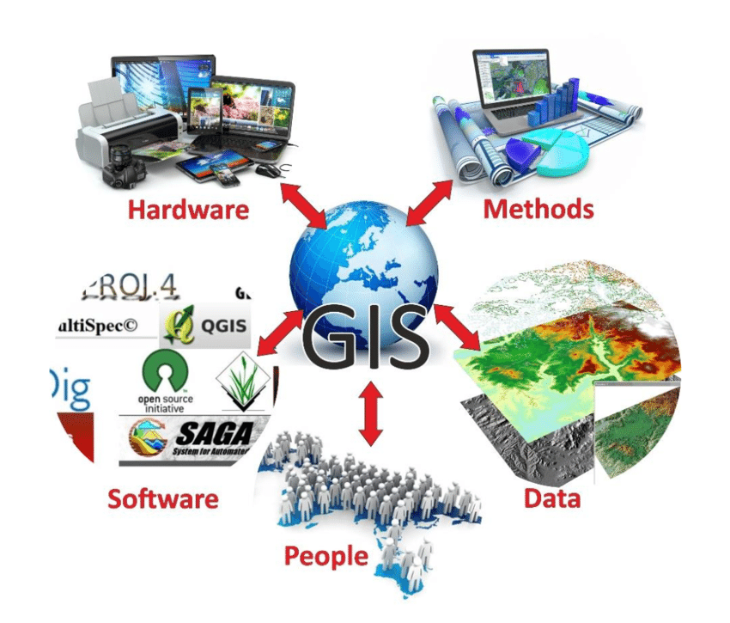
Components of GIS

Slide 11
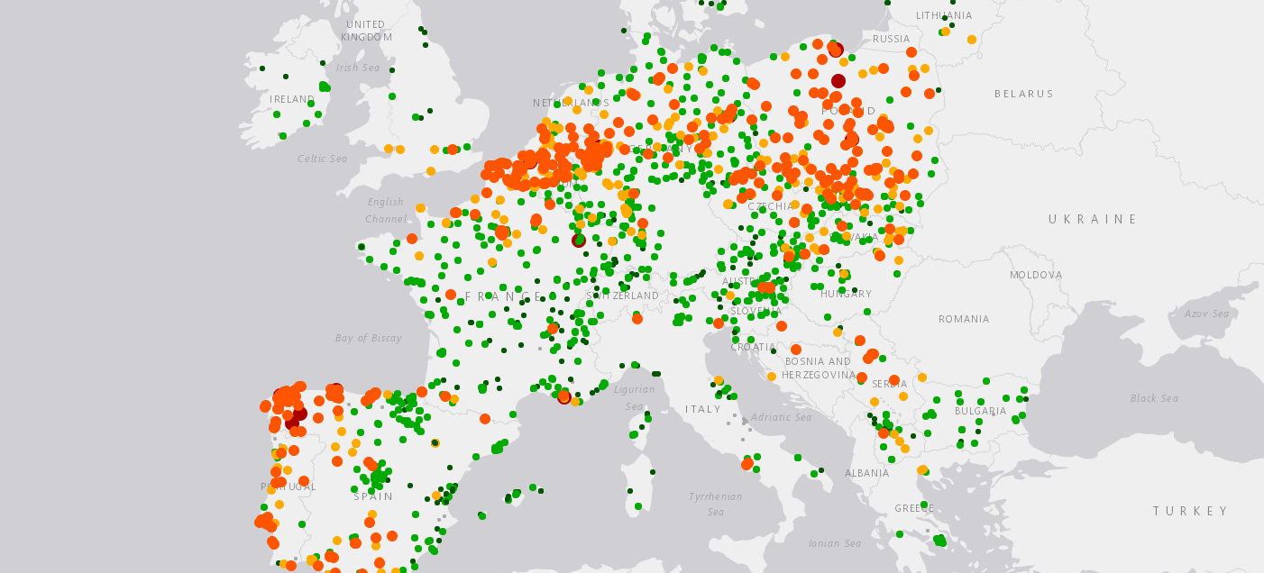
GIS for environmental monitoring
Distribution of forest / plan tree planting
Manage conservation areas / conservation strategy
Analyze water resources to solve water issues
Monitor and track animals and plants
Predict Wildlife Movement
Monitor air quality
….

Slide 12
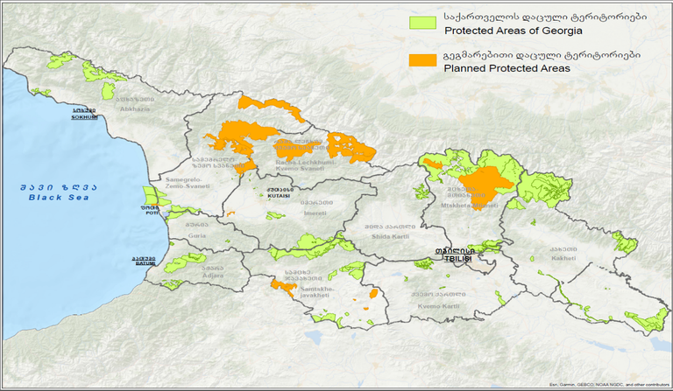
GIS projects in Georgia
Geology
Tectonic Analysis
Forests and Wildlife
Protected Areas
Infrastructure planning
Flooding monitoring and predictions
Development of eco and sustainable tourism

Slide 13
Geological map of Georgia

Slide 14
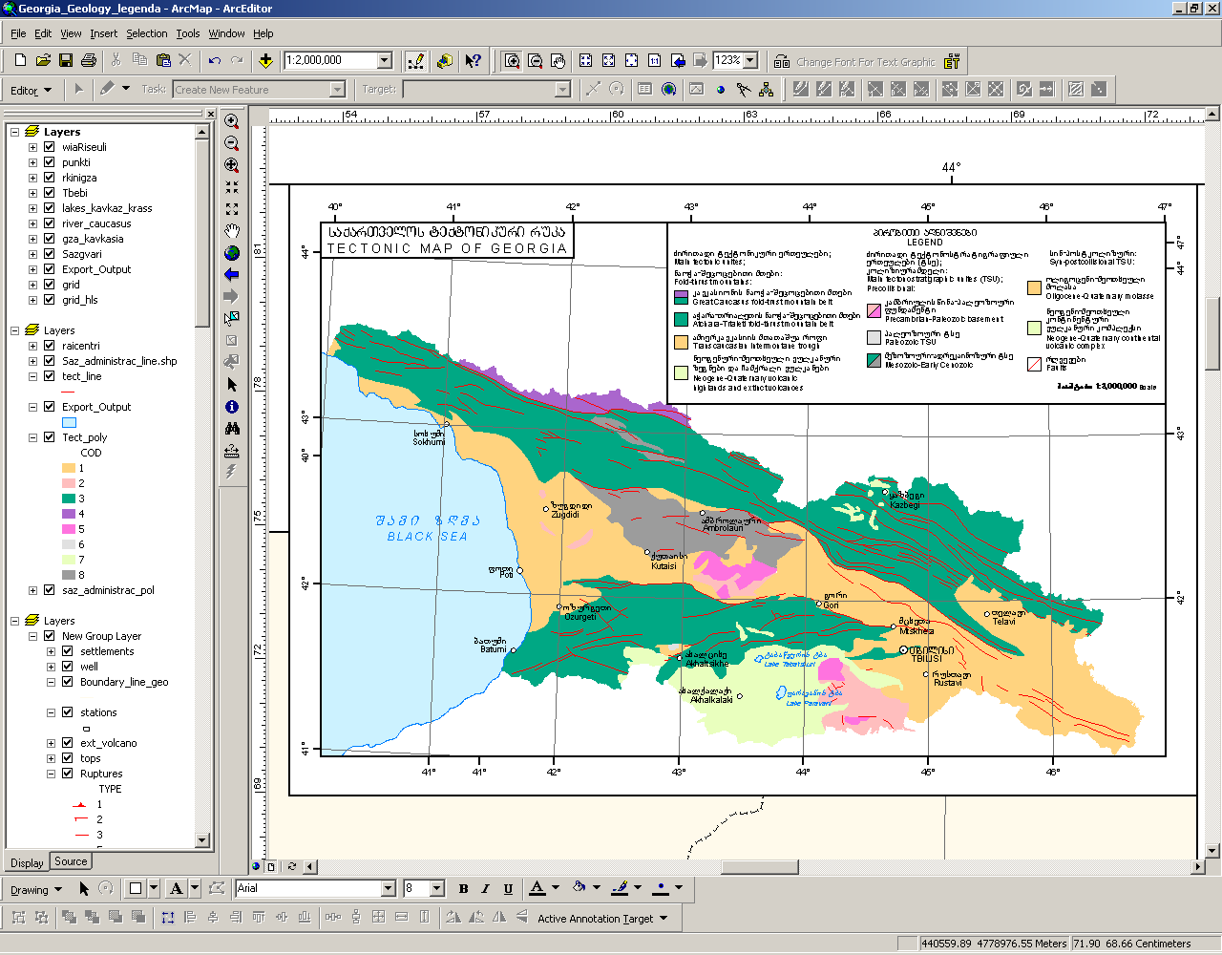
Tectonic map of Georgia

Slide 15
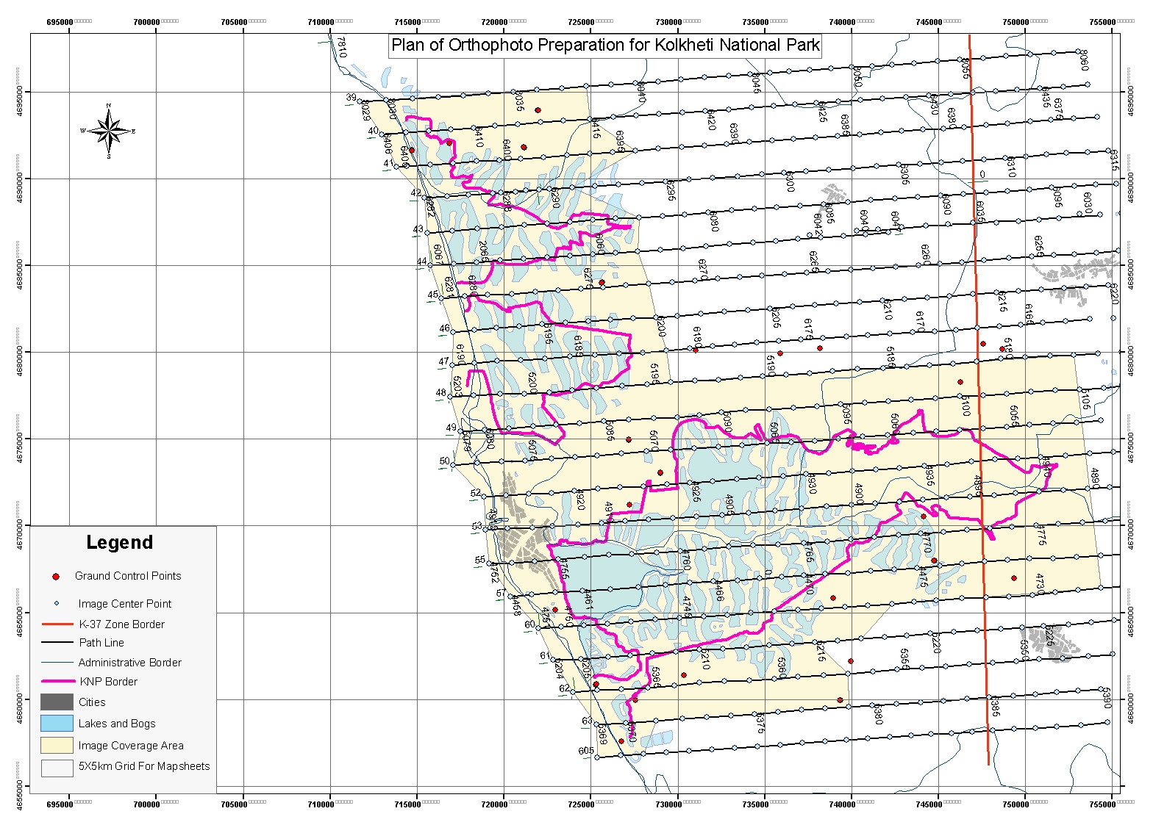
Map of Kolkheti National Park

Slide 16
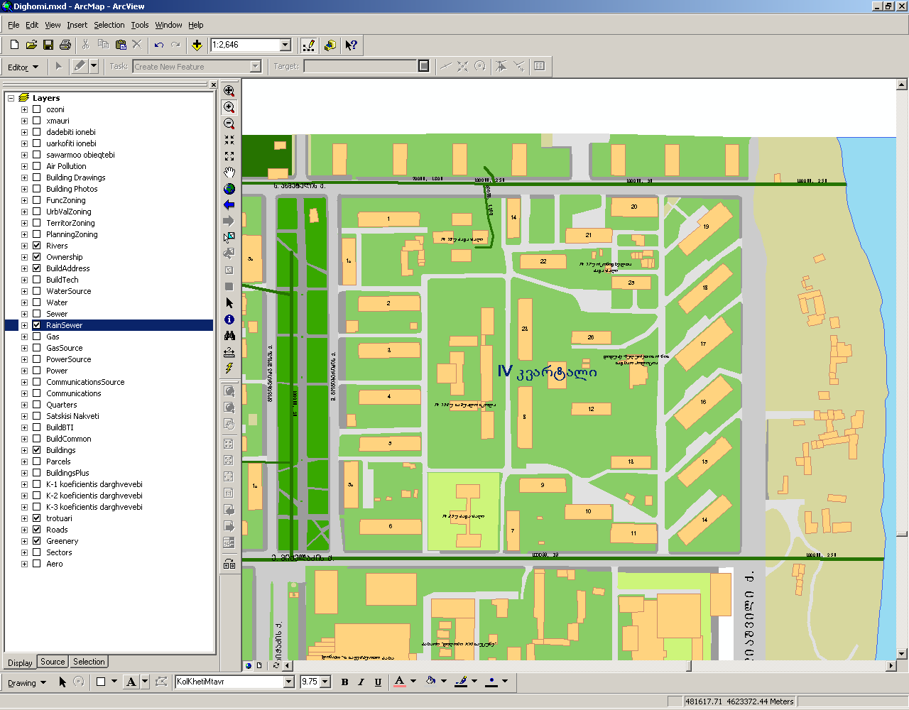
Drainage system

Slide 17
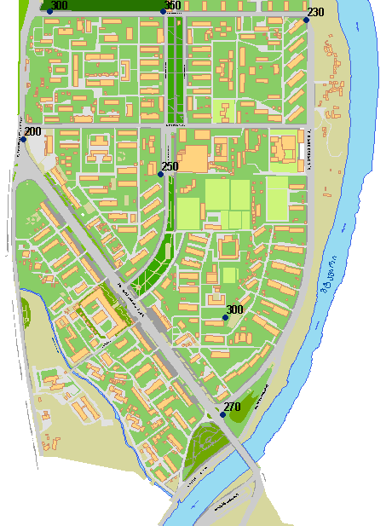
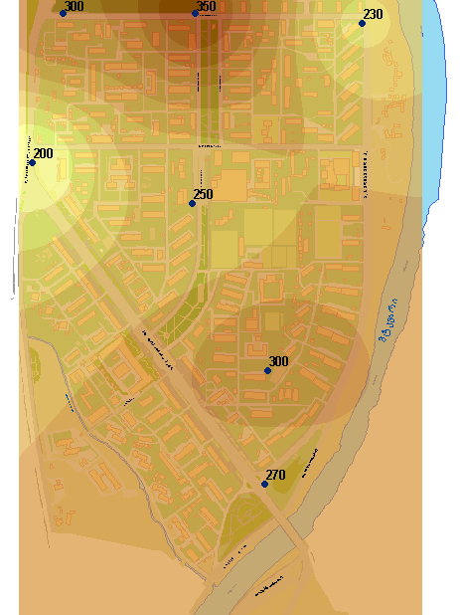
Air Pollution and Quality Maps

Slide 18
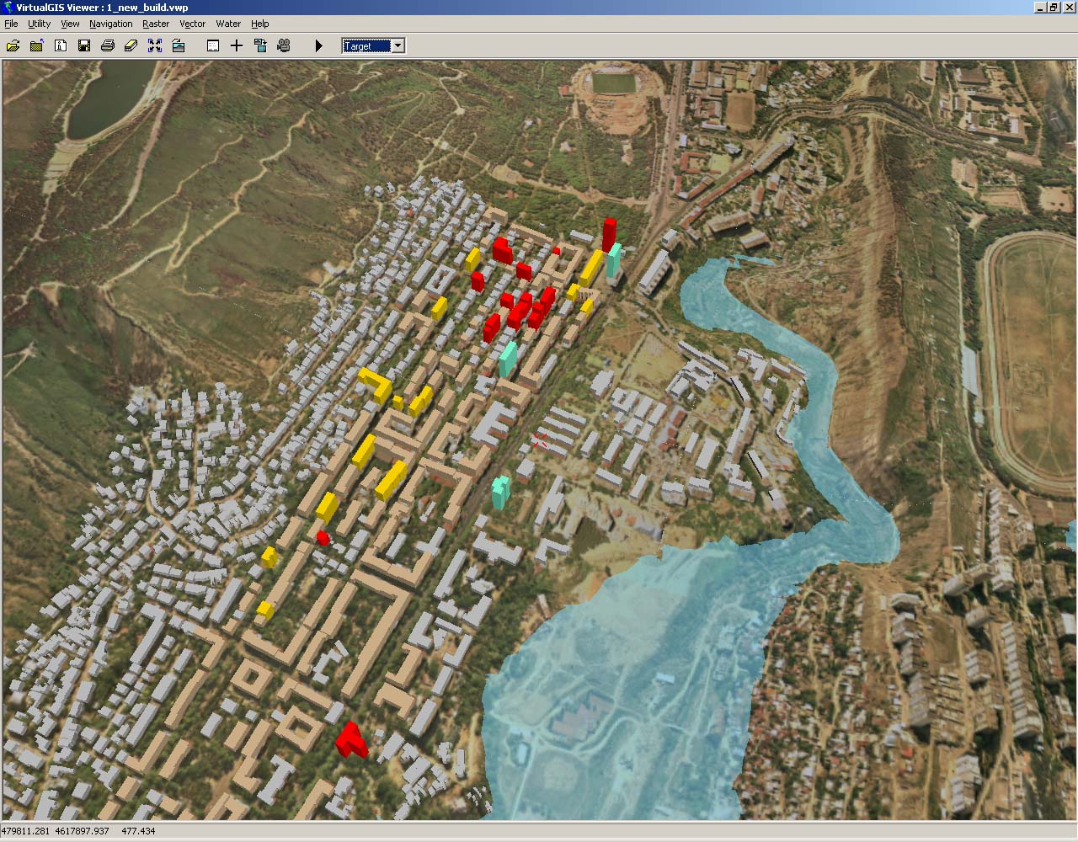
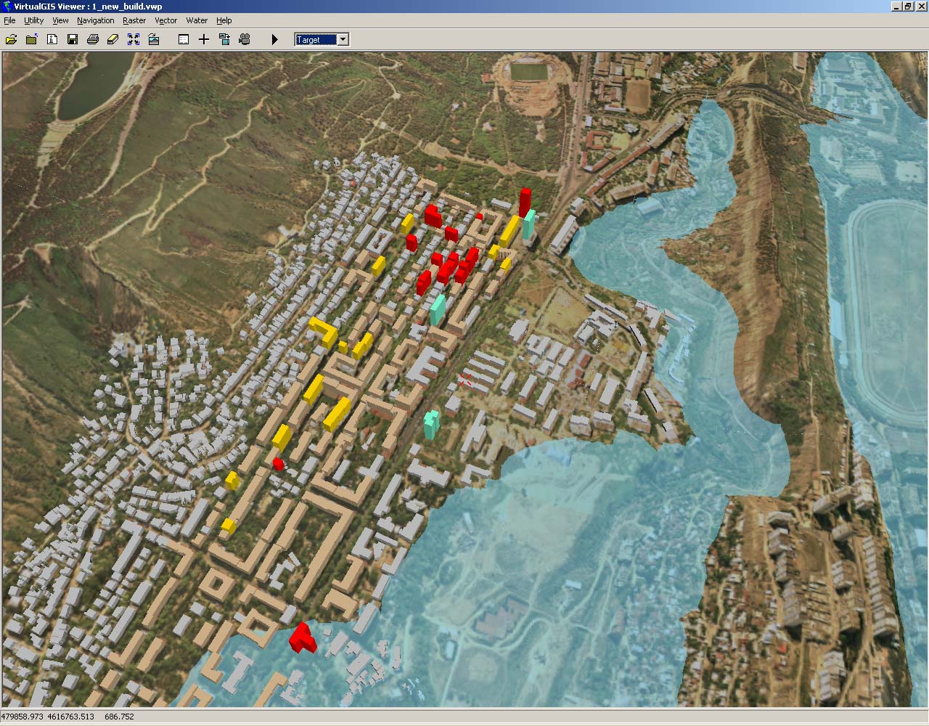
Floods 3D modeling in Tbilisi (Vere River)

Slide 19
GIS in The University of Georgia
GIS course is included in bachelors and master programs
Informatics
History
Archeology
Architecture
Healthcare
GIS in tourism course is included in bachelors program of tourism direction
Students learn to MapInfo and Arc GIS
Collect data
Create different types of maps
Analyze the maps and define strategy
Solve spatial analytical problems
Silknet GIS group was staffed by students of UG in 2010
Team created inventory and planning GIS for underground and over ground communications in entire Georgia.

Slide 20
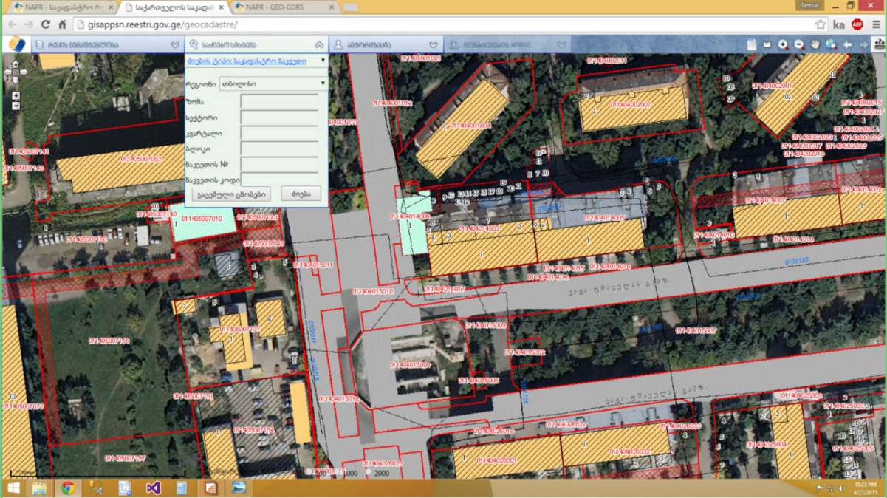
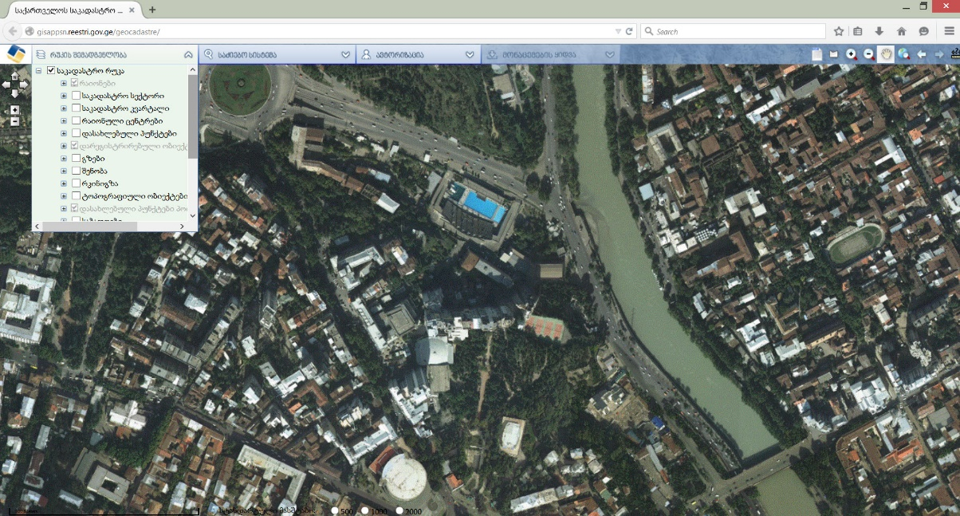
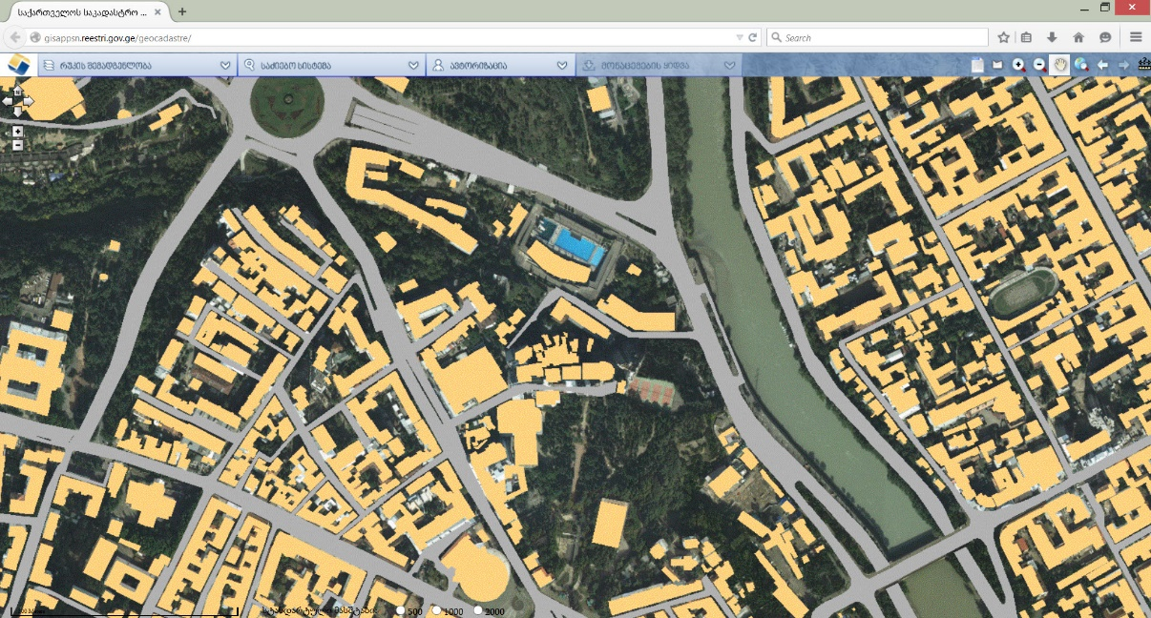
Bachelors Thesis
Dynamics of green cover change in Tbilisi 1995-2015

Slide 21
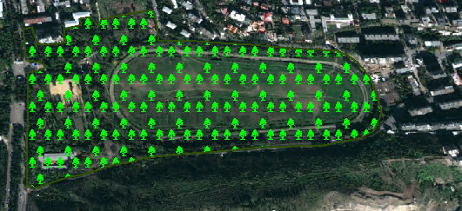
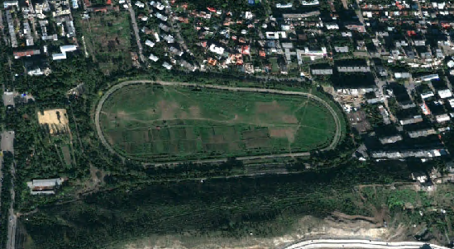
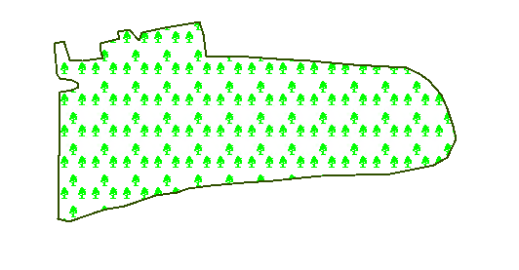
Bachelors Thesis
Creation of vector maps

Slide 22
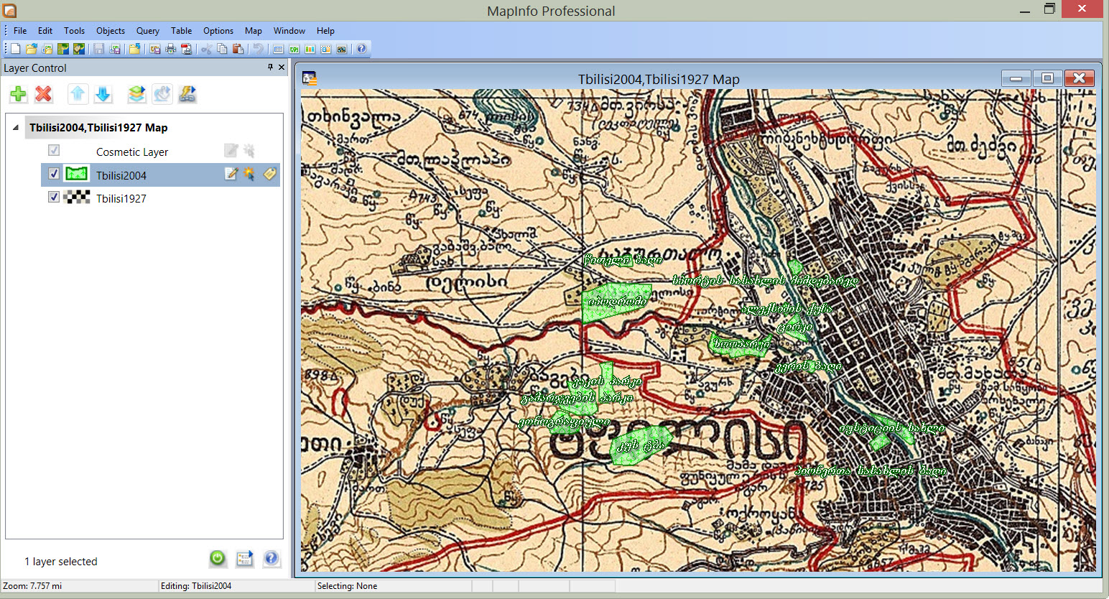
Bachelors Thesis
Vector map of green cover

Slide 23
Bachelors Thesis
Dynamics of green cover change in Tbilisi 1995-2015

Slide 24
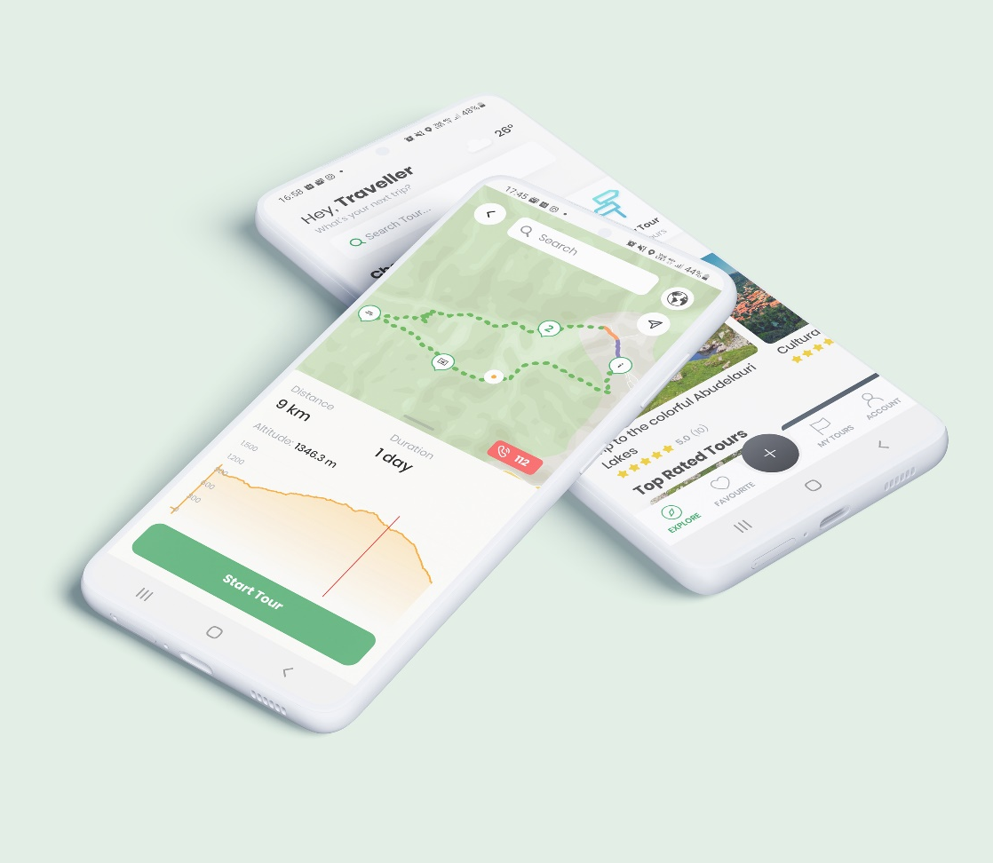
GIS in eco and sustainable tourism
The project which became a start up Biliki App
Analysis of more than 3000 natural and cultural resources of Georgia
Creation of more than 100 tours
Covering National parks of Georgia
Supports local SME, Hiking Clubs and Travel Guides
Promotes Georgia through the trails

Slide 25
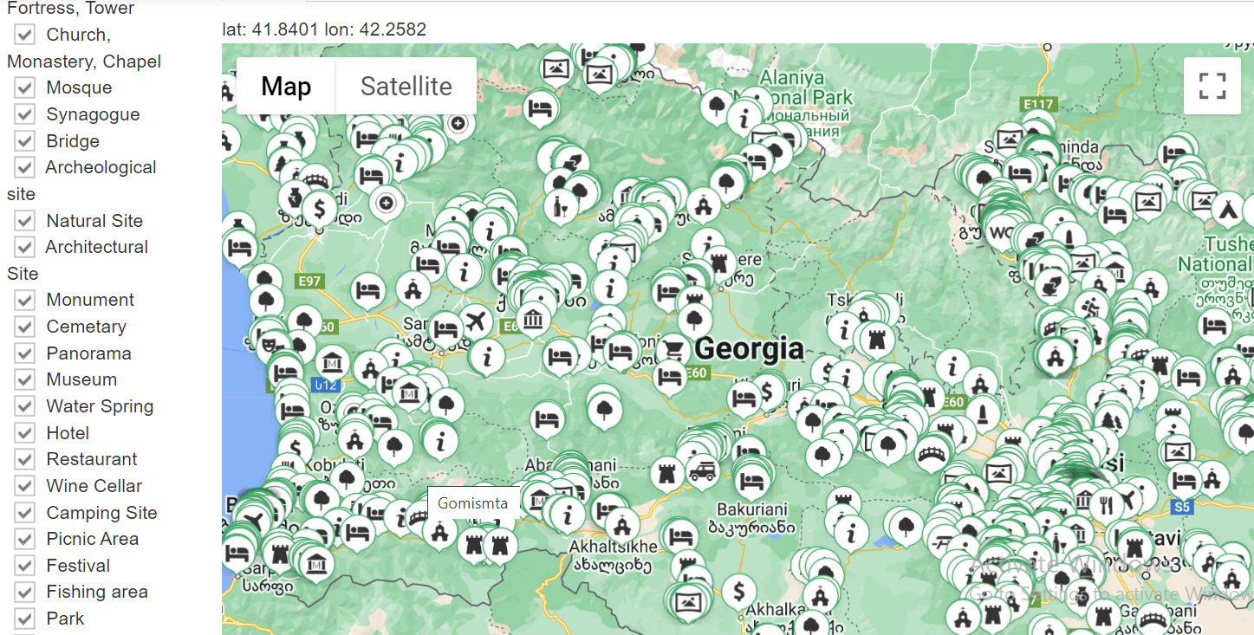
Tourism GIS Layers
More than 3000 touristic objects in 50 layers

Slide 26
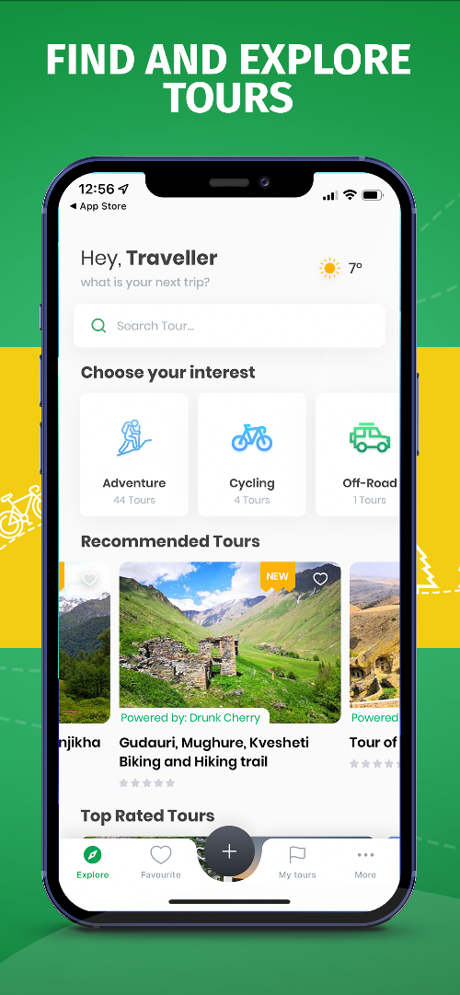
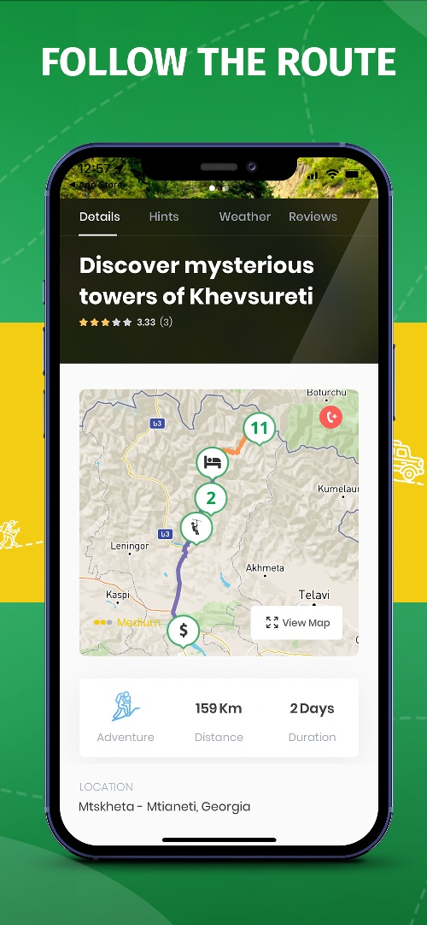
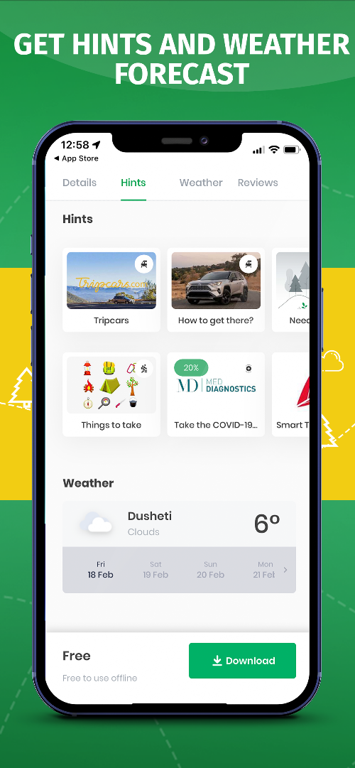
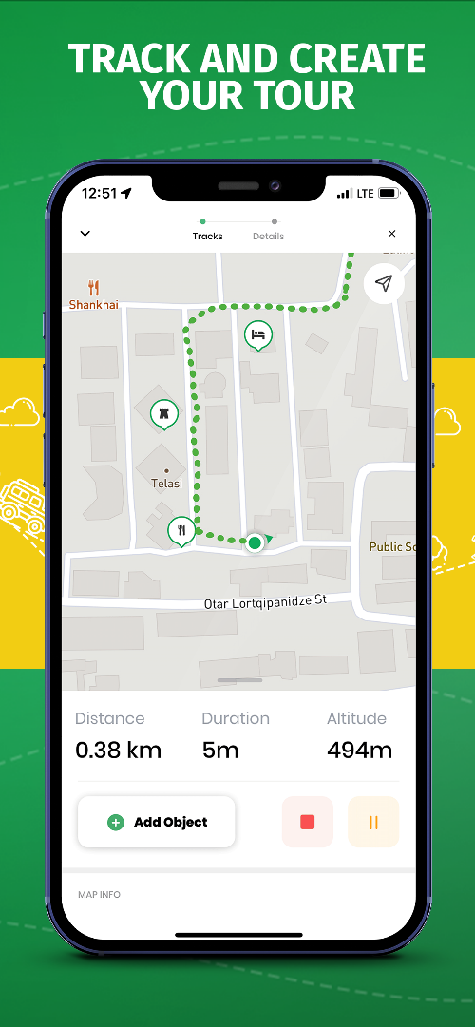
Mobile marketplace Biliki

Slide 27
Q&A
What layers and object would you use to monitor the environment?
What type of environmental monitoring would you conduct using data about rivers, lakes, reservoirs of Georgia?
What important information gathered from environmental monitoring can be useful for the tourist while selecting tours.

Slide 28
University of Georgia
School of Science and Technologies
MENVIPRO - 2022
Thank you for your attention!
Prof. Sergo Tsiramua
George Tsiramua
Tbilisi - 2022

